Slide 1
http://www.vidyanidhi.com/
ketkiacharya.net@gmail.com
Ketki Acharya
From: SM VITA ATC of CDAC
9769201036
ketkiacharya.net@gmail.com

Slide 2
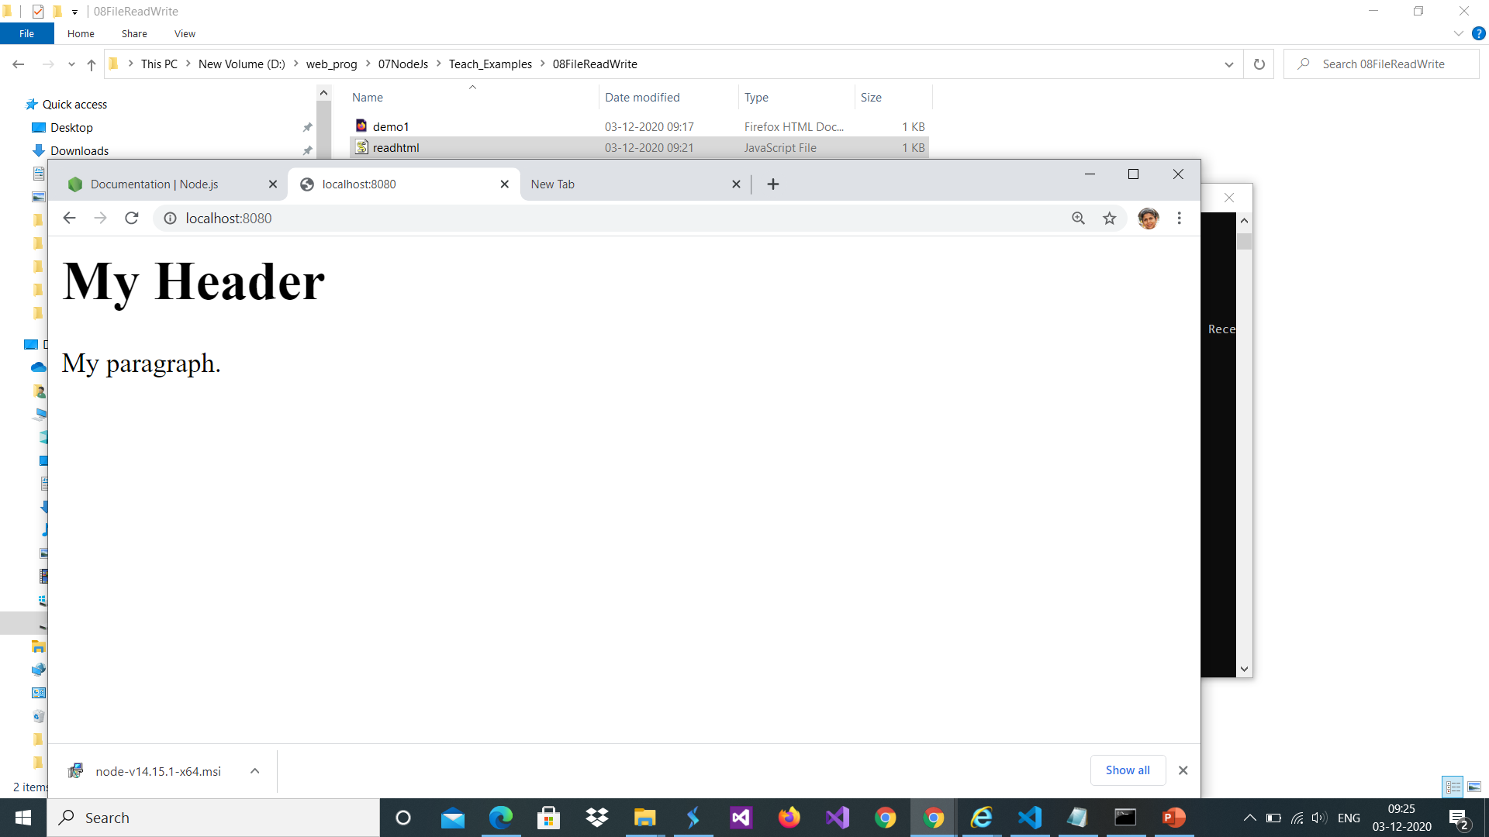
File System : Synchronous vs Asynchronous
The Node.js file system module allo ws you to work with the file system on your computer.==const fs = require('fs’);
Every method in the fs module has synchronous as well as asynchronous forms. Asynchronous methods take the last parameter as the completion function callback and the first parameter of the callback function as error. It is better to use an asynchronous method instead of a synchronous method, as the former never blocks a program during its execution, whereas the second one does.
Common use for the File System module:
Read files Create files Update files Delete files Rename files
The fs.readFile() method is used to read files on your computer.
<html> //demo1.html
<body>
<h1>My Header</h1>
<p>My paragraph.</p>
</body>
</html>
const http = require('http'); //readhtml.js
const fs = require('fs');
http.createServer(function (req, res) {
fs.readFile('demo1.html', function(err, data) {
res.writeHead(200, {'Content-Type' : 'text/html' });
res.write(data);
return res.end();
});
}).listen(8080)
fs.readFileSync('input.txt',...);
This method read file synchronously.
How to run: in command prompt
node readhtml.js
Then in browser
http://localhost:8080

Slide 3
Open a File
path − This is the string having file name including path.
flags − Flags indicate the behavior of the file to be opened. All possible values have been mentioned below.
mode − It sets the file mode (permission and sticky bits), but only if the file was created. It defaults to 0666, readable and writeable.
callback − This is the callback function which gets two arguments (err, fd).
fs.open(path, flags[, mode], callback)
Sr.No. | Flag & Description
1 | r Open file for reading. An exception occurs if the file does not exist.
2 | r+ Open file for reading and writing. An exception occurs if the file does not exist.
3 | rs Open file for reading in synchronous mode.
4 | rs+ Open file for reading and writing, asking the OS to open it synchronously. See notes for 'rs' about using this with caution.
5 | w Open file for writing. The file is created (if it does not exist) or truncated (if it exists).
6 | wx Like 'w' but fails if the path exists.
7 | w+ Open file for reading and writing. The file is created (if it does not exist) or truncated (if it exists).
8 | wx+ Like 'w+' but fails if path exists.
9 | a Open file for appending. The file is created if it does not exist.
10 | ax Like 'a' but fails if the path exists.
11 | a+ Open file for reading and appending. The file is created if it does not exist.
12 | ax+ Like 'a+' but fails if the the path exists.

Slide 4
The File System module has methods for creating new files:
fs.appendFile()
fs.open()
fs.writeFile()
The fs.appendFile() method appends specified content to a file. If the file does not exist, the file will be created:
The fs.open() method takes a "flag" as the second argument, if the flag is "w" for "writing", the specified file is opened for writing. If the file does not exist, an empty file is created:
const fs = require('fs');
//create a file named mynewfile1.txt:
fs.appendFile('newfile1.txt', 'Hello content!', function (err) {
if (err) throw err;
console.log('Saved!');
});
//The above code will create a //file 'newfile1.txt’
const fs = require('fs');
fs.open('newfile2.txt','w', function (err, file) {
if (err) throw err;
console.log('Saved!');
});

Slide 5
Writing a File
The fs.writeFile() method replaces the specified file and content if it exists. If the file does not exist, a new file, containing the specified content, will be created: It replaces the specified file and content:
path − This is the string having the file name including path.
data − This is the String or Buffer to be written into the file.
options − The third parameter is an object which will hold {encoding, mode, flag}. By default. encoding is utf8, mode is octal value 0666. and flag is 'w'
callback − This is the callback function which gets a single parameter err that returns an error in case of any writing error.
fs.writeFile(filename, data[, options], callback)
const fs = require('fs');
fs.writeFile('newfile3.txt', 'Hello content!', function (err) {
if (err) throw err;
console.log('Saved!');
});
import { writeFile } from 'fs';
writeFile('mynewfile3.txt', 'Hello content!', function (err) {
if (err) throw err;
console.log('Saved!');
});
Writefile.mjs
In ES6 instead of require we use import
You can also use npm package called esm which allows you to use
ES6 modules in Node. js.
It needs no configuration. With esm you will be able to use export/import in your JavaScript files.
On command prompt :
npm install -g esm
Also run code with following command
node --experimental-modules filename.mjs [ie. your file extention will be now .mjs]

Slide 6
fs.read(fd, buffer, offset, length, position, callback)
Read File
fd − This is the file descriptor returned by fs.open().
buffer − This is the buffer that the data will be written to.
offset − This is the offset in the buffer to start writing at.
length − This is an integer specifying the number of bytes to read.
position − This is an integer specifying where to begin reading from in the file. If position is null, data will be read from the current file position.
callback − This is the callback function which gets the three arguments, (err, bytesRead, buffer).
Close File
fs.close(fd, callback)
fd − This is the file descriptor returned by file fs.open() method.
callback − This is the callback function No arguments other than a possible exception are given to the completion callback.

Slide 7
Write and then read
var fs = require("fs");
console.log("Going to write into existing file");
fs.writeFile('input.txt', 'Simply Easy Learning!', function(err) {
if (err) {
return console.error(err);
}
fs.readFile('input.txt', function (err, data) {
if (err) {
return console.error(err);
}
console.log("Asynchronous read: " + data.toString());
});
});

Slide 8
Open Read close
fd − This is the file descriptor returned by fs.open().
buffer − This is the buffer that the data will be written to.
offset − This is the offset in the buffer to start writing at.
length − This is an integer specifying the number of bytes to read.
position − This is an integer specifying where to begin reading from in the file. If position is null, data will be read from the current file position.
callback − This is the callback function which gets the three arguments, (err, bytesRead, buffer).
var fs = require("fs");
var buf = Buffer.alloc(10024);
console.log("Going to open an existing file");
fs.open('input.txt', 'r+', function(err, fd) {
if (err) {
return console.error(err);
}
fs.read(fd, buf, 0, buf.length, 0, function(err, bytes) {
if (err) {
console.log(err);
}
// Print only read bytes to avoid junk.
if(bytes > 0) {
console.log(buf.slice(0, bytes).toString());
}
// Close the opened file.
fs.close(fd, function(err) {
if (err) { console.log(err);
}
console.log("File closed successfully.");
});
});
});

Slide 9
Delete file
path − This is the file name including path.
callback − This is the callback function No arguments other than a possible exception are given to the completion callback.
fs.unlink(path, callback)
var fs = require("fs");
console.log("Going to delete an existing file");
fs.unlink('input.txt', function(err) {
if (err) {
return console.error(err);
}
console.log("File deleted successfully!");
});

